Slide 1



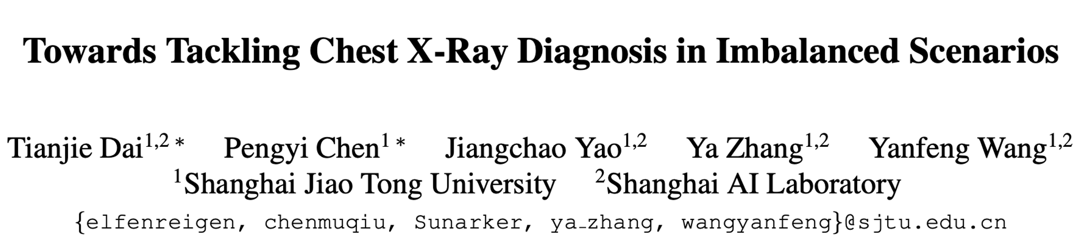
2nd in Task 1, 4th in Task 3

Slide 2
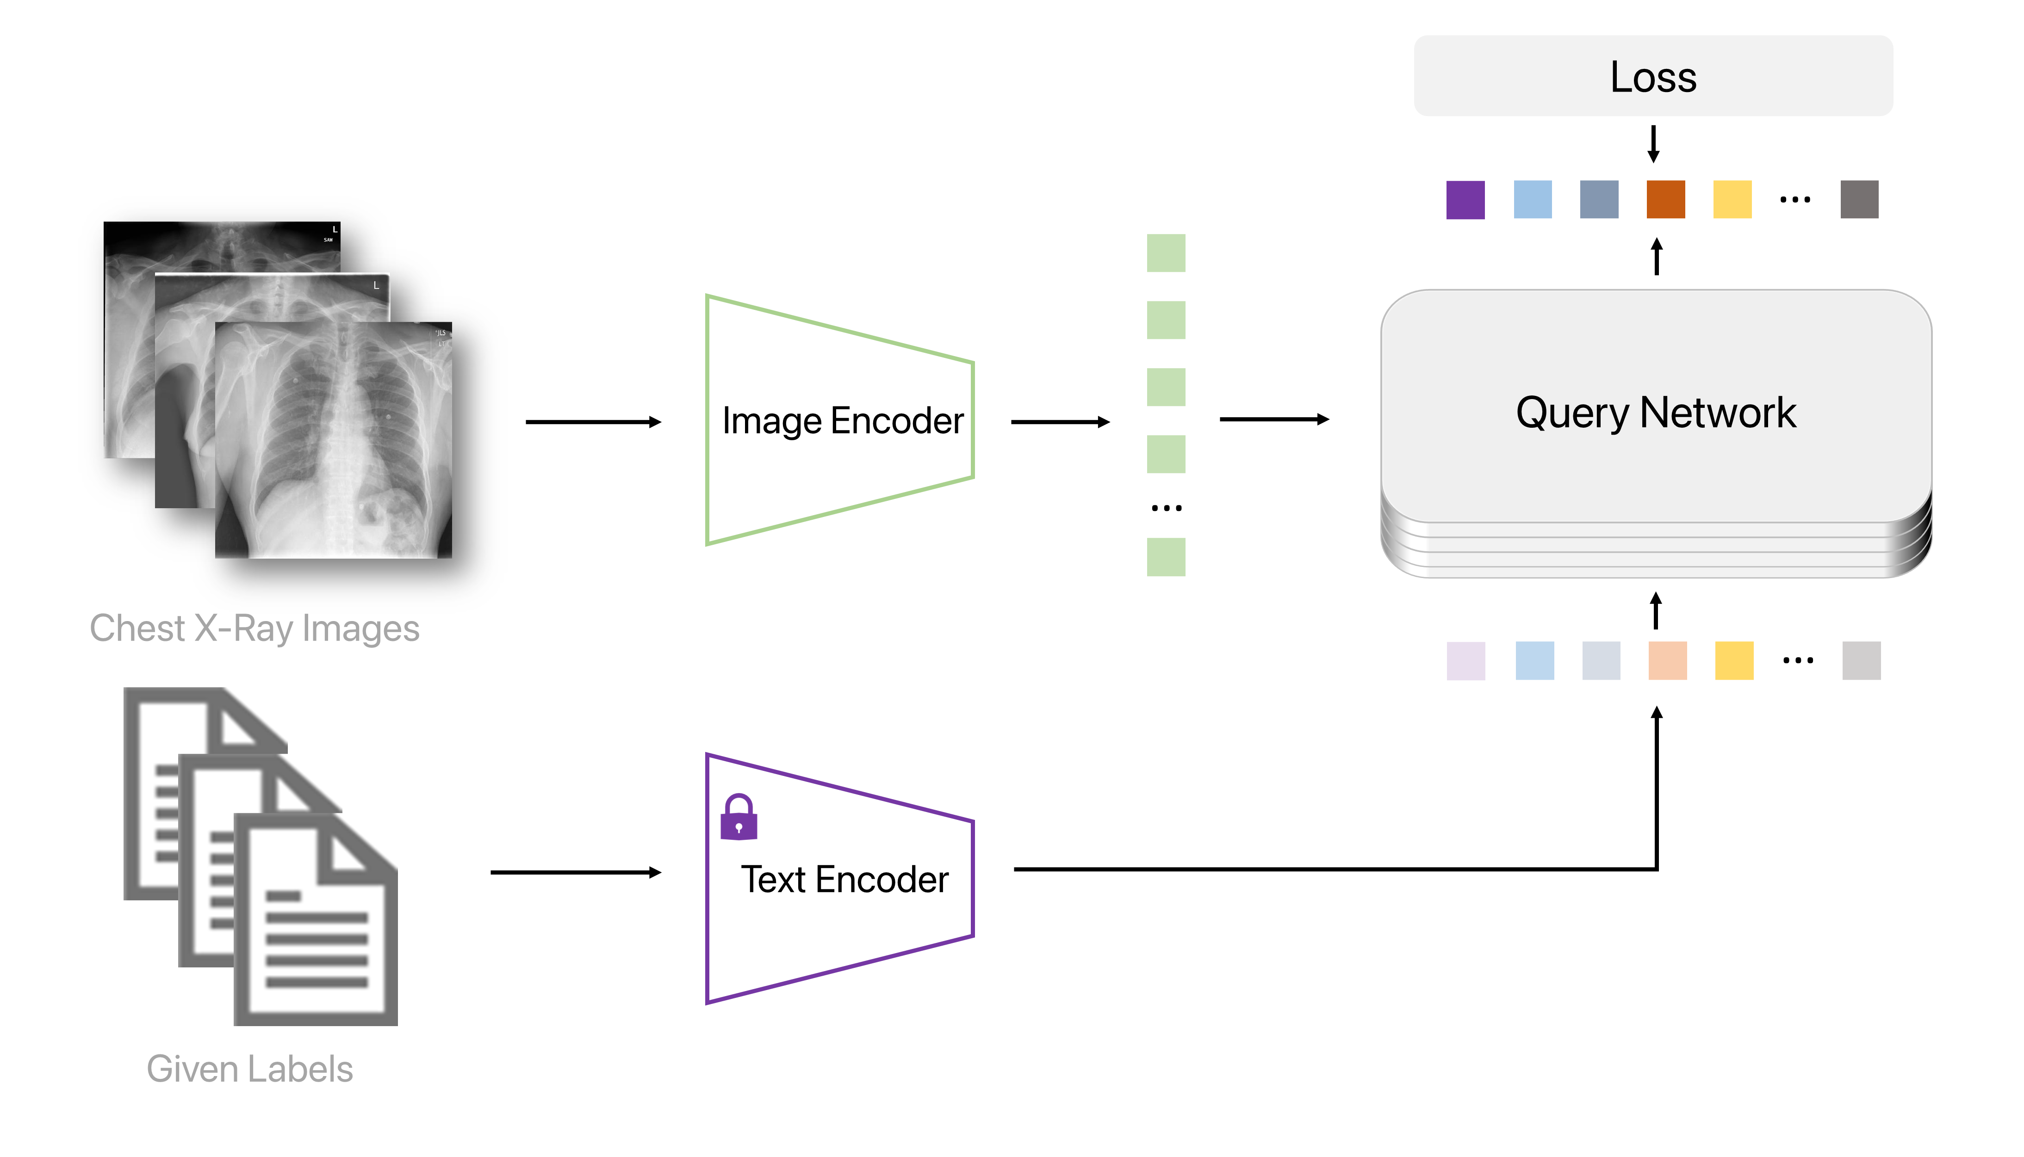
1 General Framework
Three parts: image encoder, pretrained text encoder and query network.
Problem Formulation
Dai, Tianjie, et al. "UniChest: Conquer-and-Divide Pre-training for Multi-Source Chest X-Ray Classification." IEEE Transactions on Medical Imaging (2024).

Slide 3
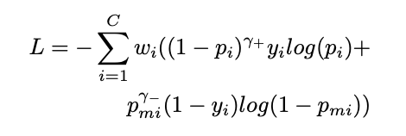
2 LT-specific designs
Design 1: Feature Extractor
Finetuned PubMedBERT in UniChest and EfficientV3-Large
Design 2: Loss Function Reweighting
Weighted ASL loss in CheXFusion
Design 3: Test-time Augmentation (TTA)
Multiple random transformations are applied on the test image and we test the model on all transformed images, and take the average prediction as the output, which improves the stability and accuracy of the prediction. Finally, we ensemble the results from multiple views within one study as the final prediction.
Design 4: Exogenous Data Replenishment
ChestXray-14, CheXpert, VinDr-CXR, BRAX
Dai, Tianjie, et al. "UniChest: Conquer-and-Divide Pre-training for Multi-Source Chest X-Ray Classification." IEEE Transactions on Medical Imaging (2024).
Kim, Dongkyun. "Chexfusion: Effective fusion of multi-view features using transformers for long-tailed chest x-ray classification." ICCVW. 2023.

Slide 4
3.1 Task 1: Experiments on development set
Attempt ID | Backbone | Resolution | Reweight | TTA | AddData | mAP
1 | Convnext-S | 512 | / | √ | √ | 0.2305
2 | Convnext-S | 512 | √ | √ | √ | 0.2412
3 | Convnext-B | 512 | / | √ | / | 0.2202
4 | Convnext-B | 512 | / | √ | √ | 0.2372
5 | Convnext-B | 512 | √ | √ | √ | 0.2485
6 | EffNet-S | 512 | / | √ | √ | 0.2509
7 | EffNet-S | 512 | √ | √ | √ | 0.2568
8 | EffNet-L | 512 | / | √ | / | 0.2579
9 | EffNet-L | 512 | / | √ | √ | 0.2601
10 | EffNet-L | 512 | √ | √ | √ | 0.2662
When backbone is EfficientV2-Large, resolution is 512, adopting re-weighting and TTA, pre-trained on the mixed multiple-source data, the best mAP score is achieved on the development set.
Apparently, the incorporation of a series of LT-specific designs help boost the chest X-rays disease diagnosis ability of the base general architecture from 0.2305 to 0.2662.
3.2 Task 3: Based on Checkpoint from Task 1
For Task 3, we further fine-tune the best model in Task 1 during development phase on one subset of PadChest which contains 20,000 samples for several epochs, which contains three label in the given 5 unseen diseases. We use three seeds to repeat this process for three times.

Slide 5
4 Final Test Phase
During the testing phase, we performed model ensemble using the top 3 best-performing single models, which achieved second place in Task 1.
For Task 3, we ensemble the prediction of three fine-tuned models and ranked the fourth.
5 Future Exploration
In future work, we plan to investigate MLLM in medical applications to further enhance the capacity of AI-aided CXR disease diagnosis.

